Slide 1

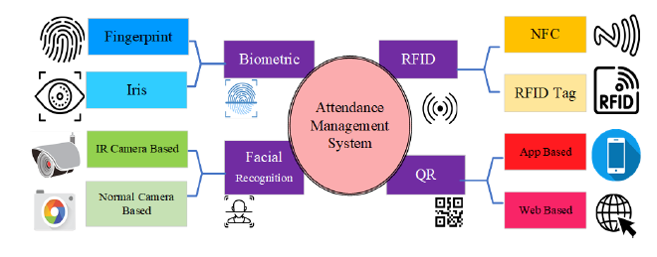


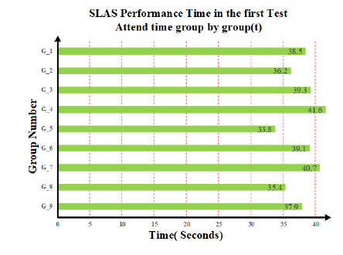
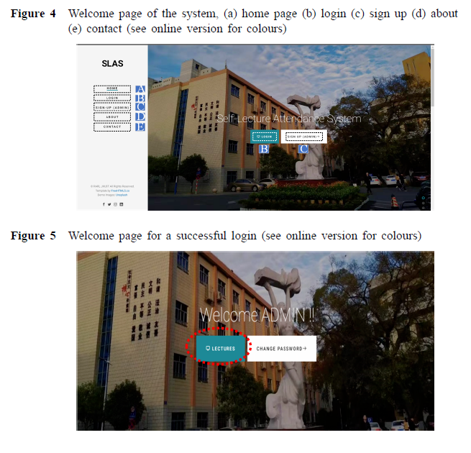
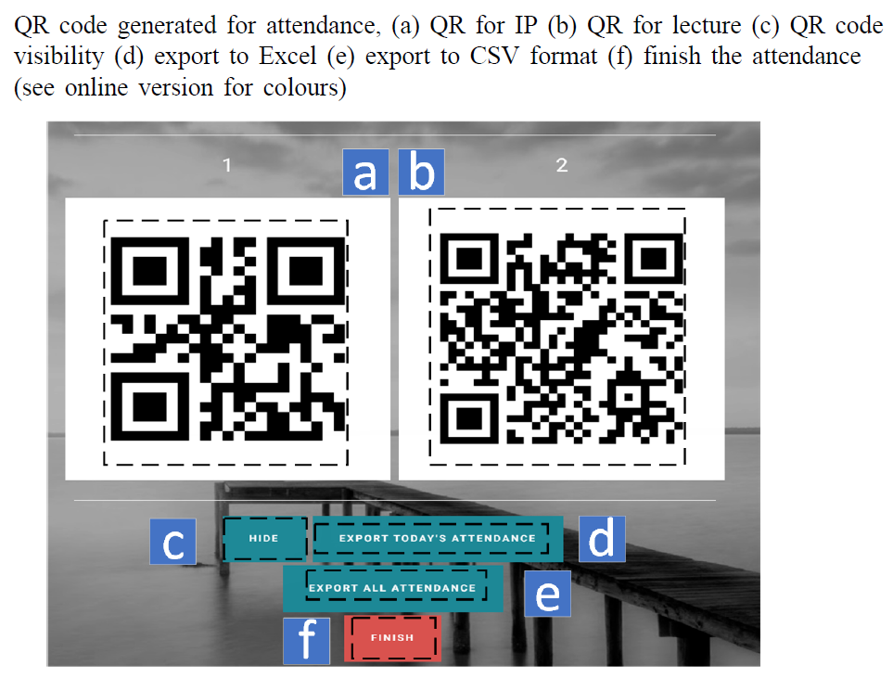
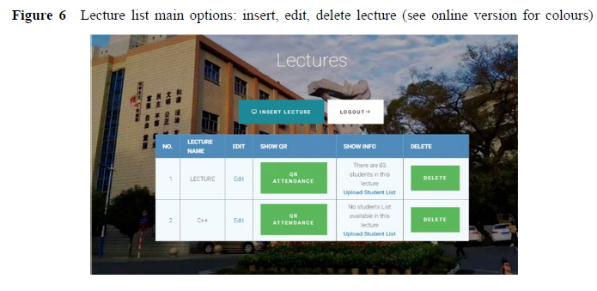
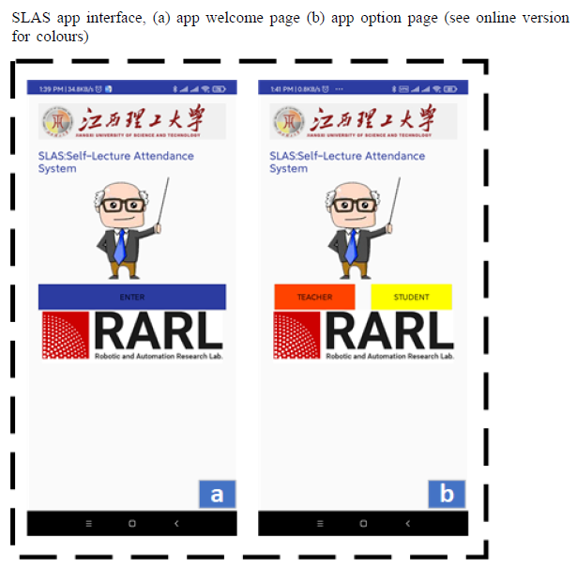
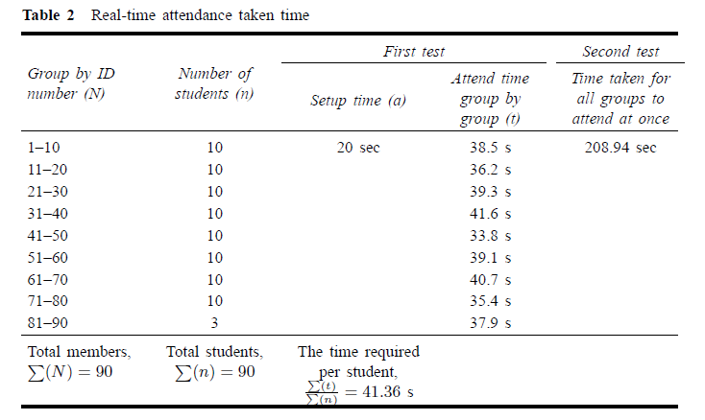

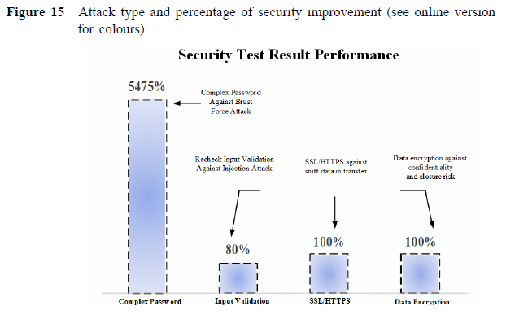



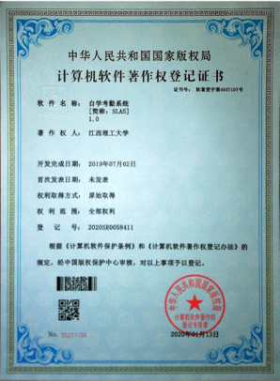
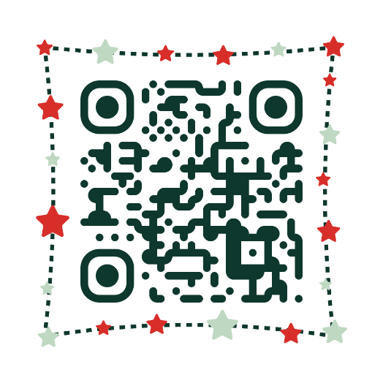

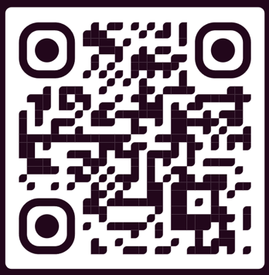
A novel IoT-enabled portable, secure automatic
self-lecture attendance system: design,
development and comparison
Abstract
INTRODUCTION
This study focuses on the importance of monitoring student
attendance in education and the challenges faced by educators in doing so. Existing methods for attendance tracking have drawbacks, including high costs, long processing times, and inaccuracies, while security and privacy concerns have often been overlooked. To address these issues, the authors present a novel internet of things (IoT)-based self-lecture attendance system (SLAS) that leverages smartphones and QR codes. This system effectively addresses security and privacy concerns while providing streamlined attendance tracking. It offers several advantages such as compact size, affordability, scalability, and flexible features for teachers and students.Empirical research conducted in a live lecture setting demonstrates the efficacy and precision of the SLAS system. The authors believe that their system will be valuable for educational institutions aiming to streamline attendance tracking while ensuring security and privacy.
The Self-Lecture Attendance System (SLAS) is a novel IoT-enabled solution designed to streamline student attendance management in educational institutions. Traditional methods like biometric, RFID/NFC, and QR code systems face challenges such as high costs, environmental dependencies, and security concerns. SLAS overcomes these limitations by integrating dynamic QR codes with cloud-based processing, ensuring fast, secure, and cost-effective attendance tracking. It enhances security, supports multiple users, and is scalable for institutions of all sizes. With improved efficiency and accessibility, SLAS offers a modern, reliable alternative to traditional attendance systems.
DISCUSSION
RESULTS
The SLAS system streamlines attendance tracking with a secure web and mobile app, utilizing Java, MySQL, and Android for efficient operation. The web app acts as the server, while the mobile app allows students to scan QR codes for attendance. Security features like complex passwords, SSL/HTTPS encryption, and data encryption protect user data. The system’s database structure handles lecture and attendance records, with teachers able to export data in CSV format for analysis. Results show that the system enhances efficiency in classroom management, providing a smooth, automated attendance process for both teachers and students.
SLAS booted in 55 ± 5 seconds and completed attendance in 204 seconds (lab) / 209 seconds (classroom). Each student took 41.36 seconds on average. The system proved efficient, cost-effective, and user-friendly. Security measures, including stronger passwords, input validation, and asymmetric encryption, significantly improved resistance against attacks. Penetration tests identified vulnerabilities like weak Wi-Fi encryption and short passwords, which were addressed with recommended fixes.
METHODS AND MATERIALS
The SLAS IoT-enabled solution consists of a Raspberry Pi 3B+ as the primary hardware, connected via Wi-Fi to a router for communication, and an Android-based mobile application. The system ensures security using SSL certificates, HTTPS, and WPA2 encryption. The software includes a web-based service and a mobile app developed in Java and Android Studio, with a MySQL database and an MVC architecture for modular deployment. Teachers use the web interface to generate dynamic QR codes, while students scan them using the mobile app to register attendance. The server verifies entries through token-based authentication, updating records in real time. SLAS enhances accuracy, security, and scalability, offering a modern, automated alternative to traditional attendance systems.
CONCLUSIONS
The proposed attendance system based on IoT provides the following key advantages:
Cost-effective & Portable: SLAS integrates IoT and cloud computing, eliminating the need for expensive hardware or software modifications.
Fast & Efficient: Attendance verification for 83 students is completed in approximately three minutes.User-Friendly: Compact, easy to use, and nearly plug-and-play with an intuitive GUI.
Security & Privacy: Enhanced protection for teachers and students, with plans for multi-factor authentication (MFA).
Future Improvements: Expansion to iOS and integration of facial and emotion recognition for student engagement assessment.
Ideal for Education: A scalable, efficient, and low-cost solution for educational institutions.
This innovative attendance system overcomes the limitations of existing methodologies and provides a highly efficient, secure, and cost-effective solution for educational institutions.
Published result
Moshayedi, Ata Jahangir, et al. "A novel IoT-enabled portable, secure automatic self-lecture attendance system: design, development and comparison." International Journal of Electronic Security and Digital Forensics 16.6 (2024): 663-689.

Slide 2
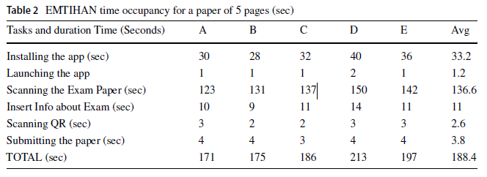
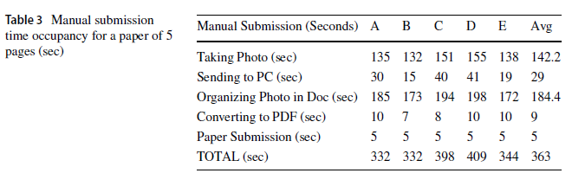
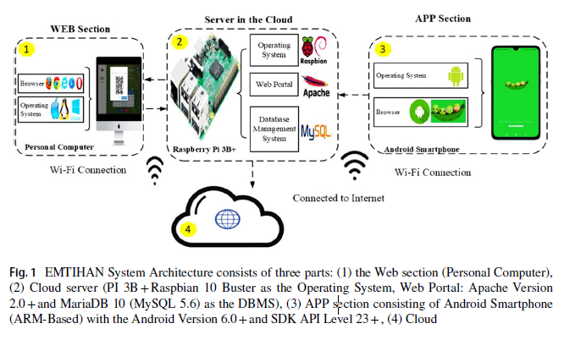
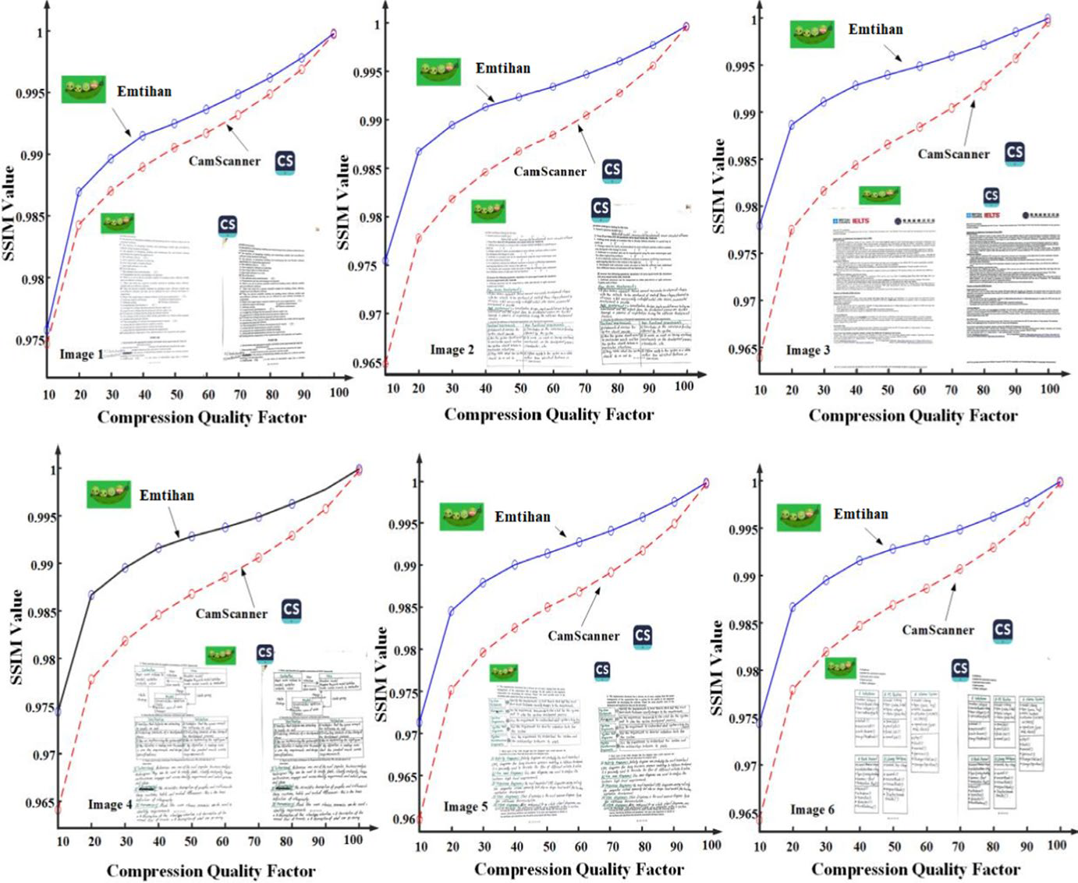
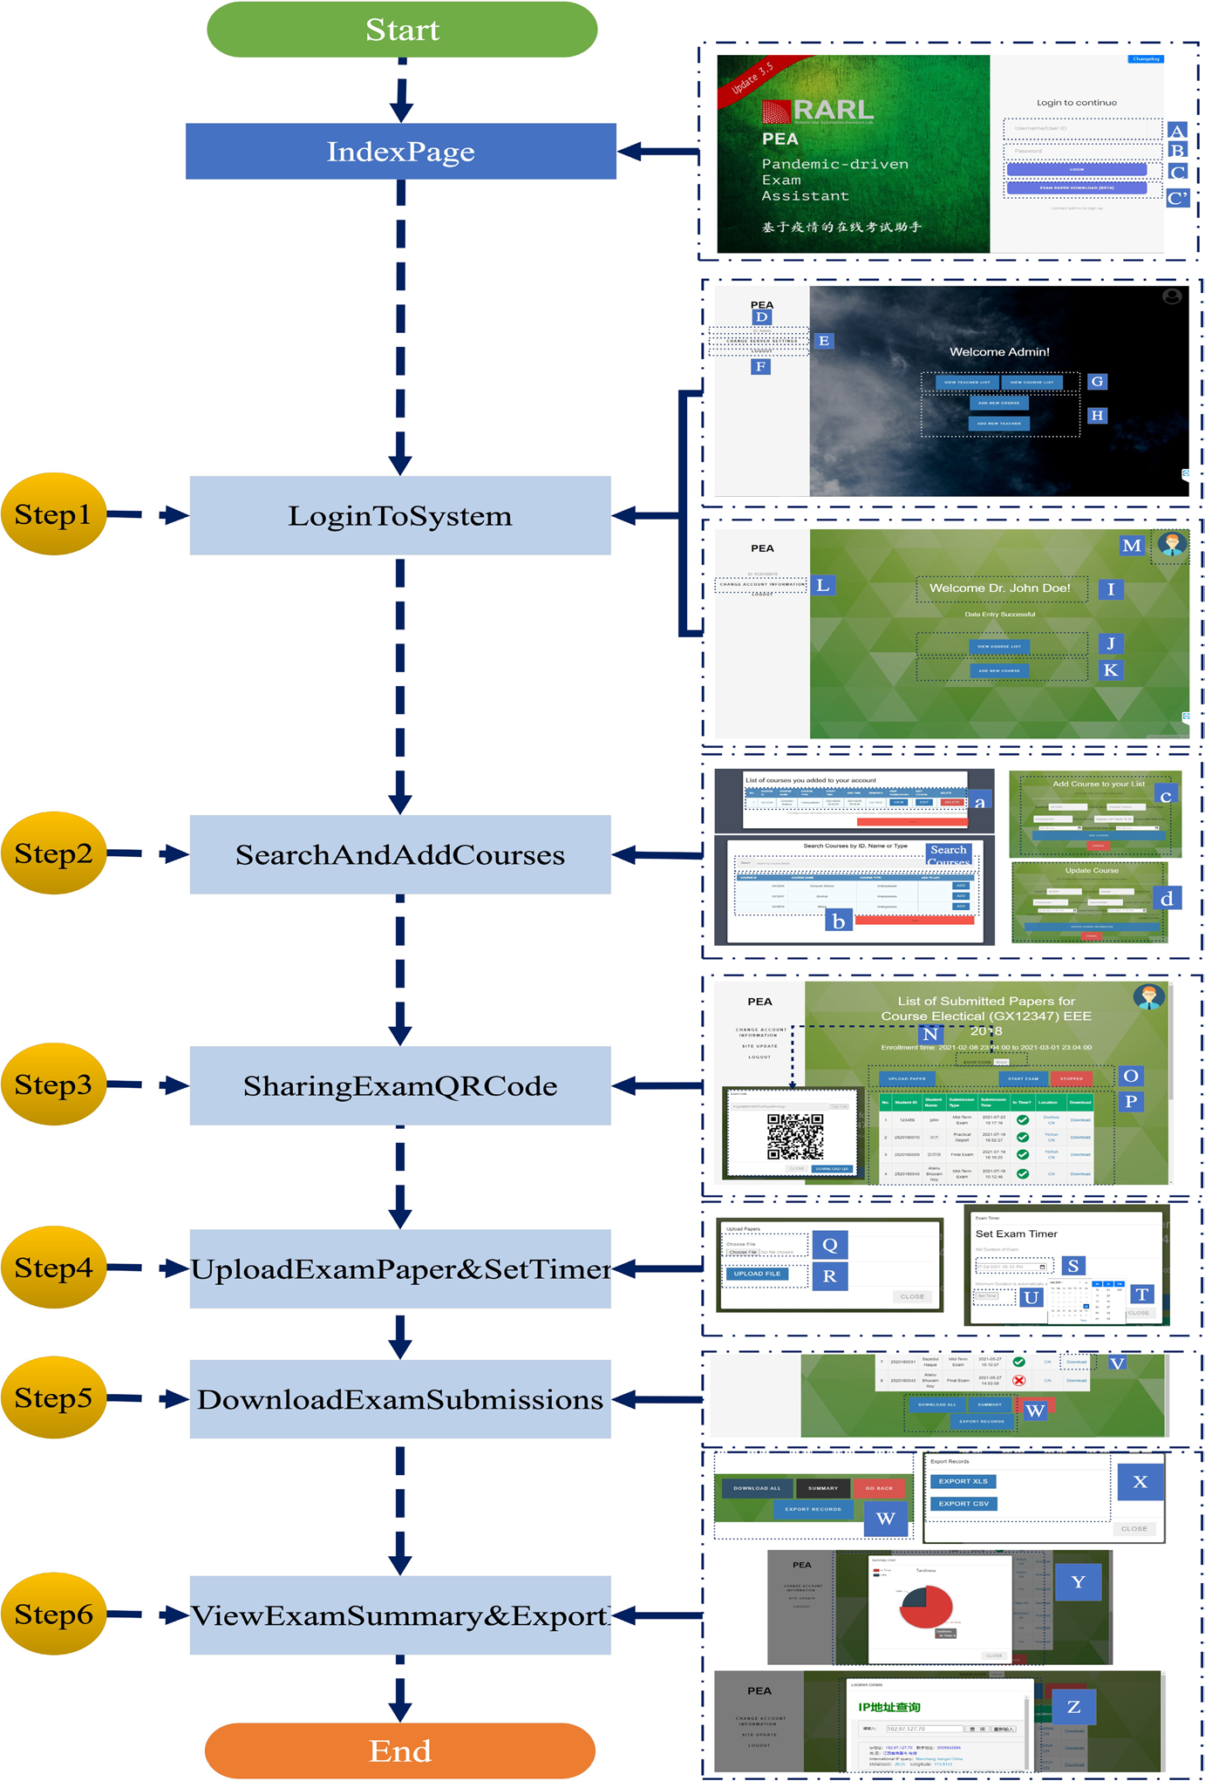

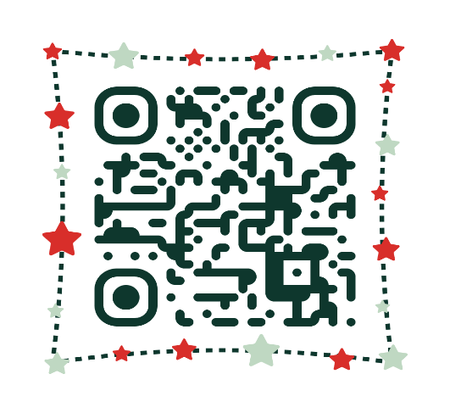
EMTIHAN: Design of a novel approach to secure online examination challenge in remote learning
Abstract
INTRODUCTION
In this paper, a secure exam proctoring assistant ‘EMTIHAN’ (which means exam in Arabic/Persian Urdu/Turkish languages) is developed to address concerns related to online exams for handwritten topics by allowing students to submit their answers online securely via their mobile devices. This system is designed with an aim to lessen the student’s burden of exam submission by offering portable hardware and easy-to-use cloud infrastructure. The main contribution of this research is to design an innovative system for online examination (in remote or distance learning scenarios) and using mixed methods i.e. both quantitative and qualitative data collection and analysis to verify its performance. The comparative results regarding submission time and security features have proven the efficacy of EMTIHAN against manual submission with participants across 5 countries using purposive sampling and currently available solutions e.g. Chaoxing MOOC and Google Classroom with 94.5% student satisfaction rate. Furthermore, app scan quality is measured using structural similarity index measure comparing with popular CamScanner app showing better quality despite image compression.
The COVID-19 pandemic disrupted education globally, leading to the rapid adoption of online learning and exam systems. However, online exams face challenges such as security, time management, and digital literacy, especially for science and engineering courses requiring handwritten assessments. Existing systems primarily support MCQs and short answers but lack robust solutions for secure, handwritten submissions. EMTIHAN, a proposed framework, addresses these gaps by ensuring information preservation, high-quality data transfer, and secure proctoring using IoT, blockchain, and 5G/6G technologies. Unlike previous systems, EMTIHAN facilitates handwritten exam uploads in real-time and enhances security with multi-factor authentication and AI-driven monitoring.
RESULTS
METHODS AND MATERIALS
The EMTIHAN testing involved a multi-step evaluation of the app's performance, quality, and usability. Test Set 1 analyzed the time from app installation to paper submission, showing that EMTIHAN allowed students to submit a five-page paper in 3.14 minutes, nearly twice as fast as the manual method, which took about 6 minutes. Test Set 2 compared manual submission, where students converted images to PDF and submitted via WeChat. EMTIHAN was significantly faster, averaging 3.14 minutes, compared to 6 minutes for the manual method.
The methodology of the EMTIHAN system involves two main components: hardware and software, working together to digitize and manage handwritten exam submissions. Teachers interact with a web-based platform to upload exam papers, set time limits, generate QR codes for student submissions, and track exam progress. The mobile app, used by students, allows them to scan their handwritten exam papers, convert them into PDFs, and upload them using QR codes. The system utilizes Raspberry Pi for hosting, a wireless router for connectivity, and an Android smartphone for the app. The software includes a PHP-based web portal for teacher management, while the mobile app is built using Android SDK and Kotlin to facilitate scanning and submission. The system ensures smooth data handling with session management, user authentication, and storage, while employing image processing techniques like cropping, rotating, and applying filters to enhance scanned documents before uploading them to the server.
Test Set 3 assessed image quality, comparing EMTIHAN with CamScanner, a popular text-to-PDF app. Test Set 4 demonstrated EMTIHAN's ability to handle submissions from students in various countries without data corruption, with only a 2-minute delay. Finally, Test Set 5 showed that EMTIHAN significantly reduced submission time compared to manual methods, improving efficiency without affecting submission accuracy.
The app employs a custom image enhancement filter using OpenCV, grayscale conversion, and color handling to improve visibility and accuracy. It integrates file processing utilities, including PDF creation, and an upload service supporting features like concurrent uploads, retry mechanisms, notifications, and progress tracking. The system operates on a client-server architecture, ensuring scalability and efficiency with asynchronous task processing and background optimization for reliable performance.
CONCLUSIONS
This work addresses challenges in online handwritten exams and proposes the EMTIHAN proctored exam system, designed to overcome these issues. EMTIHAN utilizes a Raspberry Pi 3B+ for portability and integrates features like handwriting support, automatic PDF conversion, encryption, and secure file handling. It offers smooth global accessibility, mobile compatibility, and multiple language support, with easy integration into existing systems. Compared to traditional manual submission, EMTIHAN significantly reduces submission time and improves image quality. The system is also more effective than other solutions like Chaoxing MOOC and GCR, with a 94.5% popularity rating. Future work includes optimizing image scanning with OCR, improving LaTeX conversion, and expanding device compatibility to reduce limitations such as the need for a stable internet connection and specific hardware requirements.
Published result
Moshayedi, A.J., Roy, A.S., Khan, Z.H. et al. EMTIHAN: Design of a novel approach to secure online examination challenge in remote learning. Educ Inf Technol (2024). https://doi.org/10.1007/s10639-024-13170-4

